Slide 1
INTRODUCTION
Geely Autos is planning on setting up a local manufacturing unit in Nigeria to take over the Nigerian Autospace.
The model built will help Geely Autos understand what affects the pricing of cars, drives demand for automobiles and the factors affecting the pricing of cars in Nigeria.

Slide 2
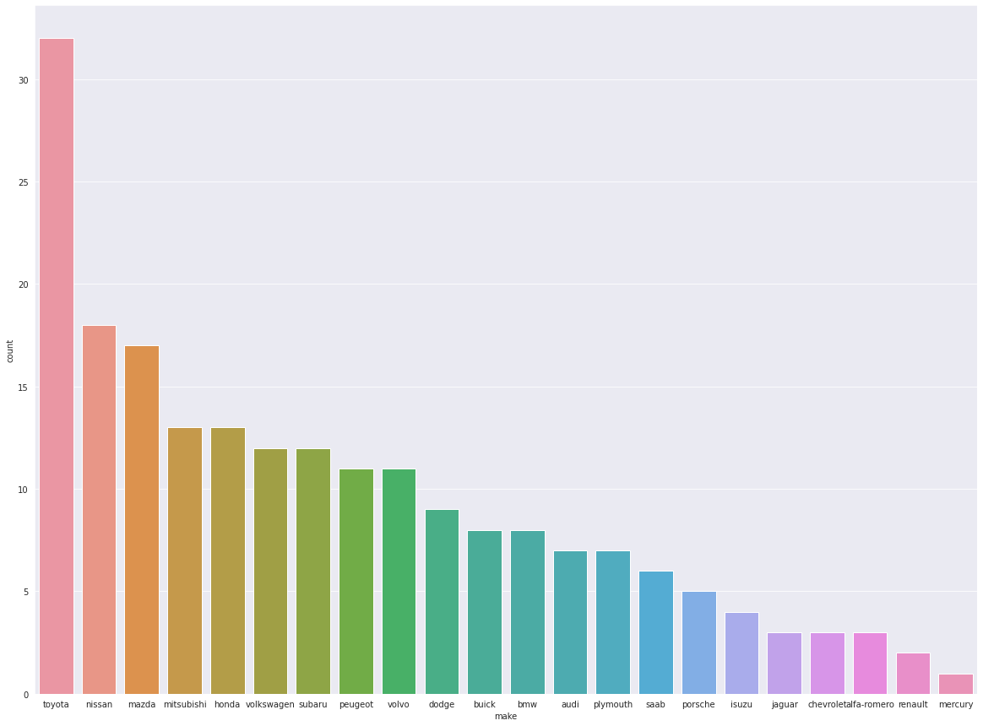
Competition
For a business to adapt to a new environment, the major competitors have to be identified.

Slide 3
Toyota sold the most cars, 15.6% of all the cars sold within that period.
Toyota’s average price is 9885.81, pretty close to the minimum price but they were able to generate the highest sales(316346). Their low prices help them sell many cars.
BMW sell luxury cars but managed to almost sell as much as Toyota. That means that there is also demand for luxury cars.

Slide 4
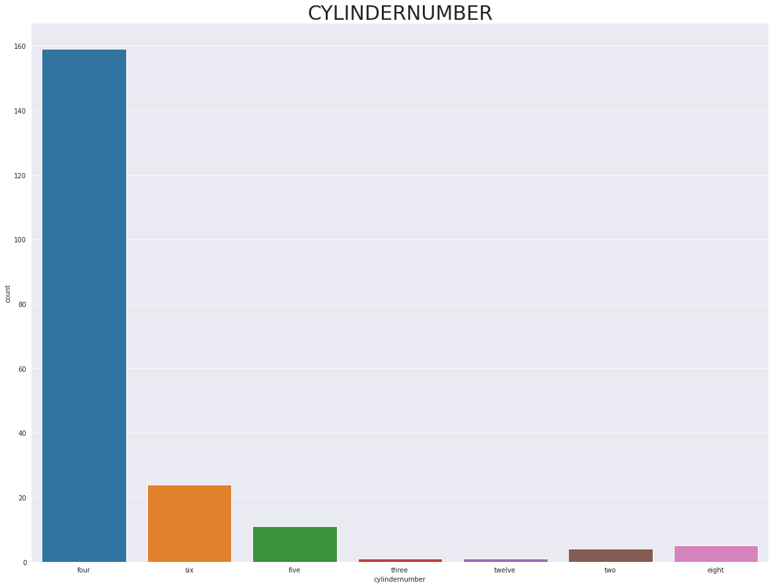
Cylinders
80% of buyers chose cars with less that 5 cylinders. There is a strong correlation between car prices and engine size.

Slide 5
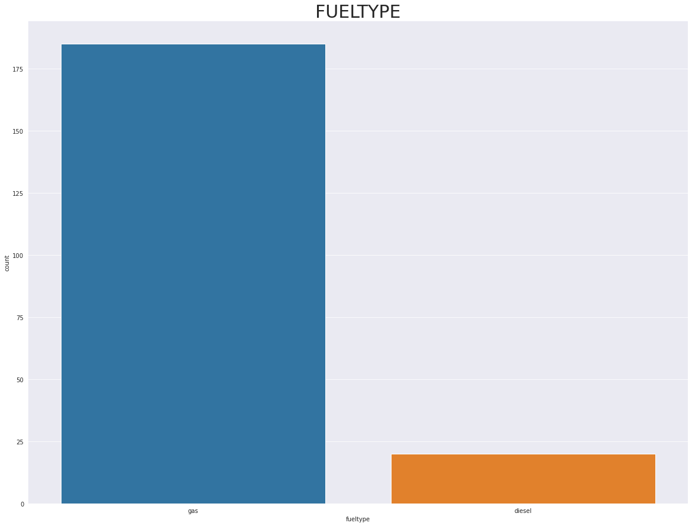
Fuel Type
90.24% of cars bought within this period do not use diesel

Slide 6
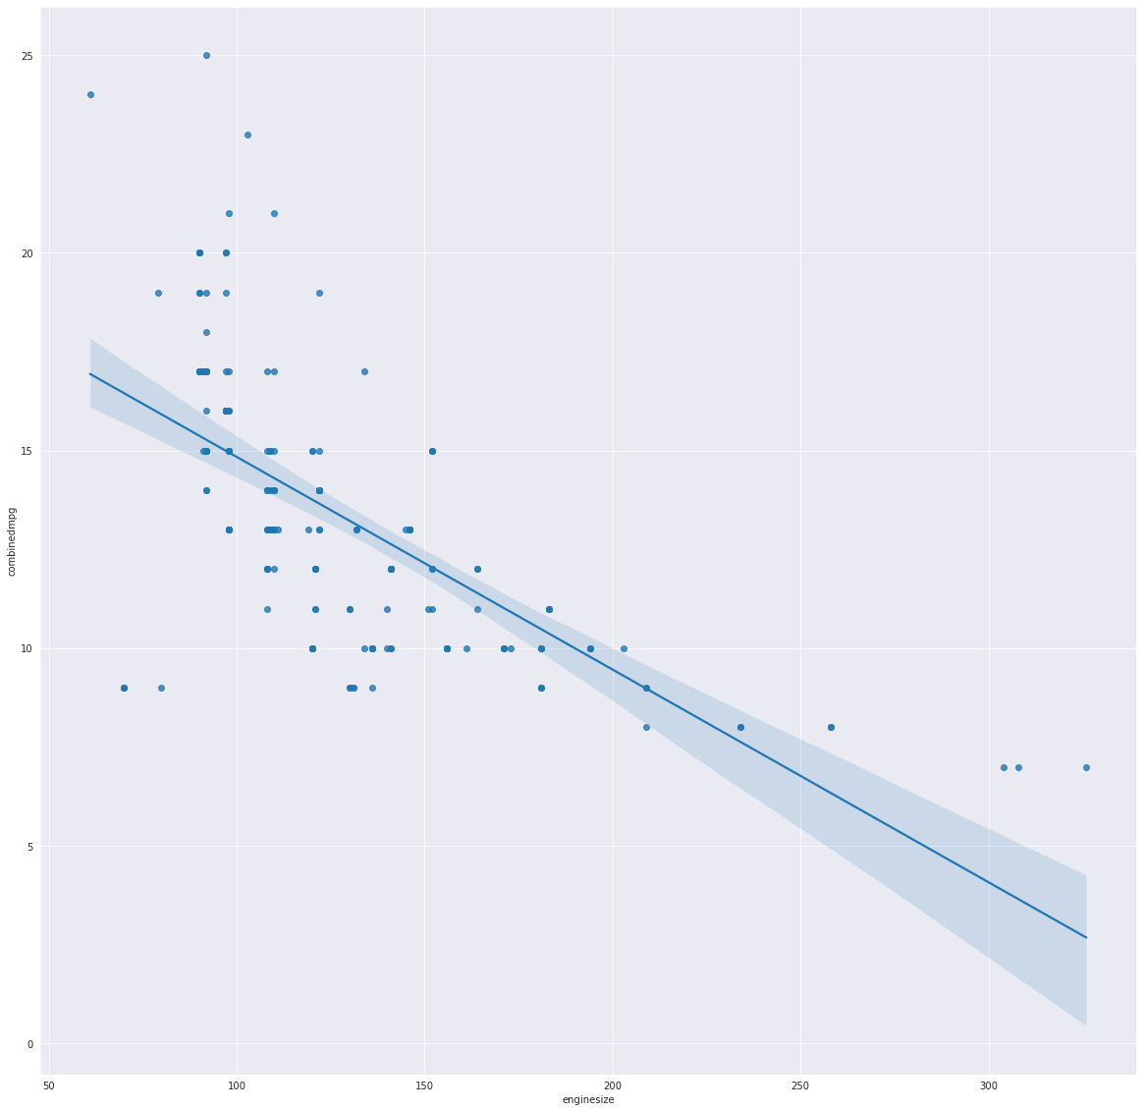
Fuel Economy
From the data, we deduce that larger engines perform poorly in terms of fuel economy, despite providing more energy

Slide 7
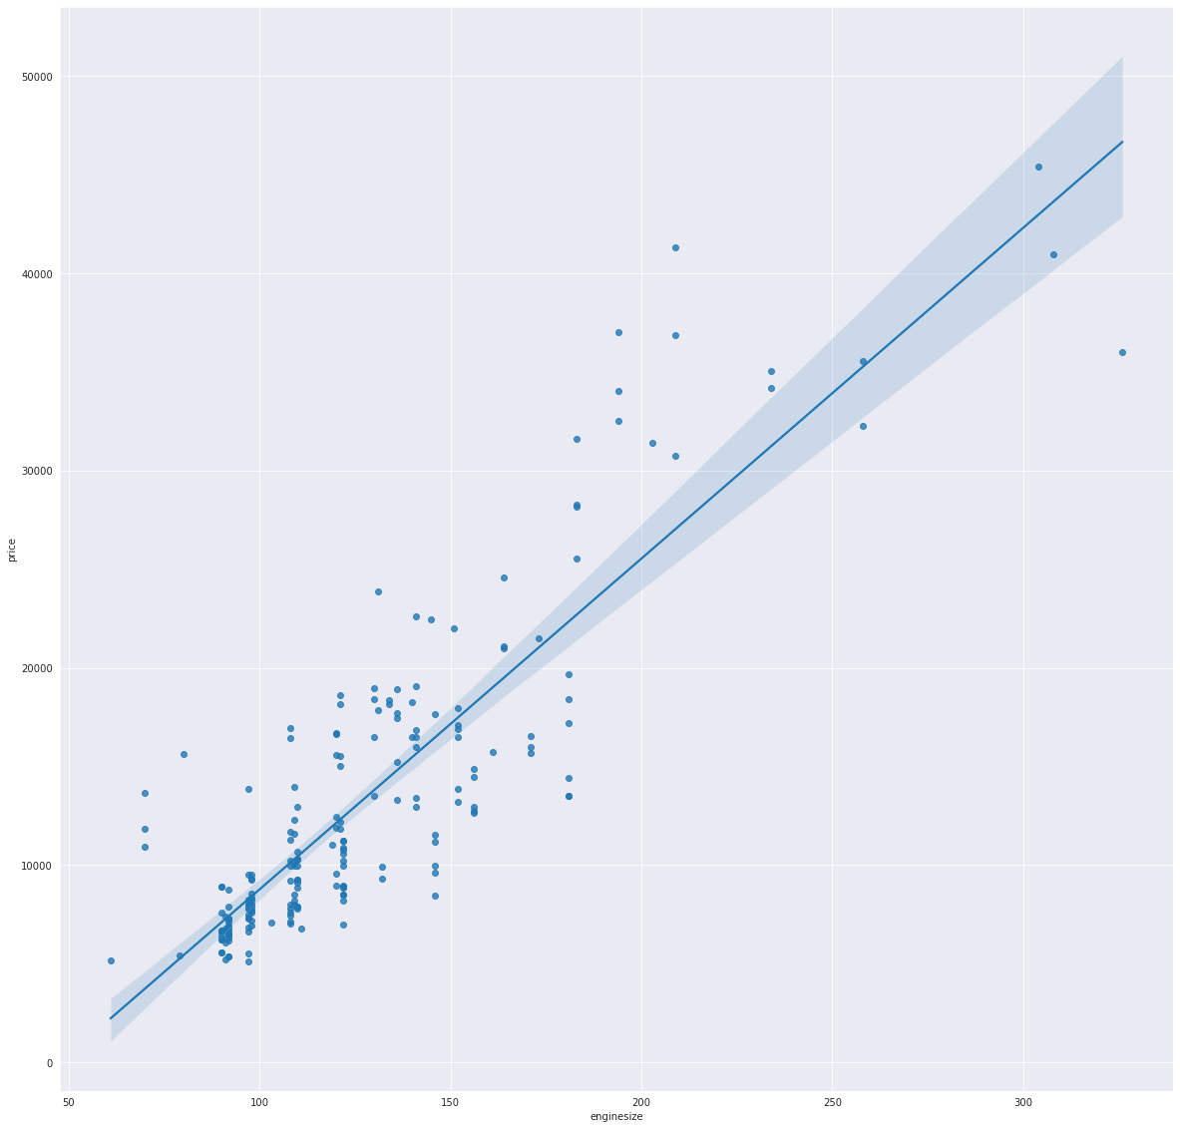
Engine Size
And it appears that car prices here are positively affected by an increase in engine size.
It is no wonder that customers prefer cars with smaller engines and less cylinders.

Slide 8
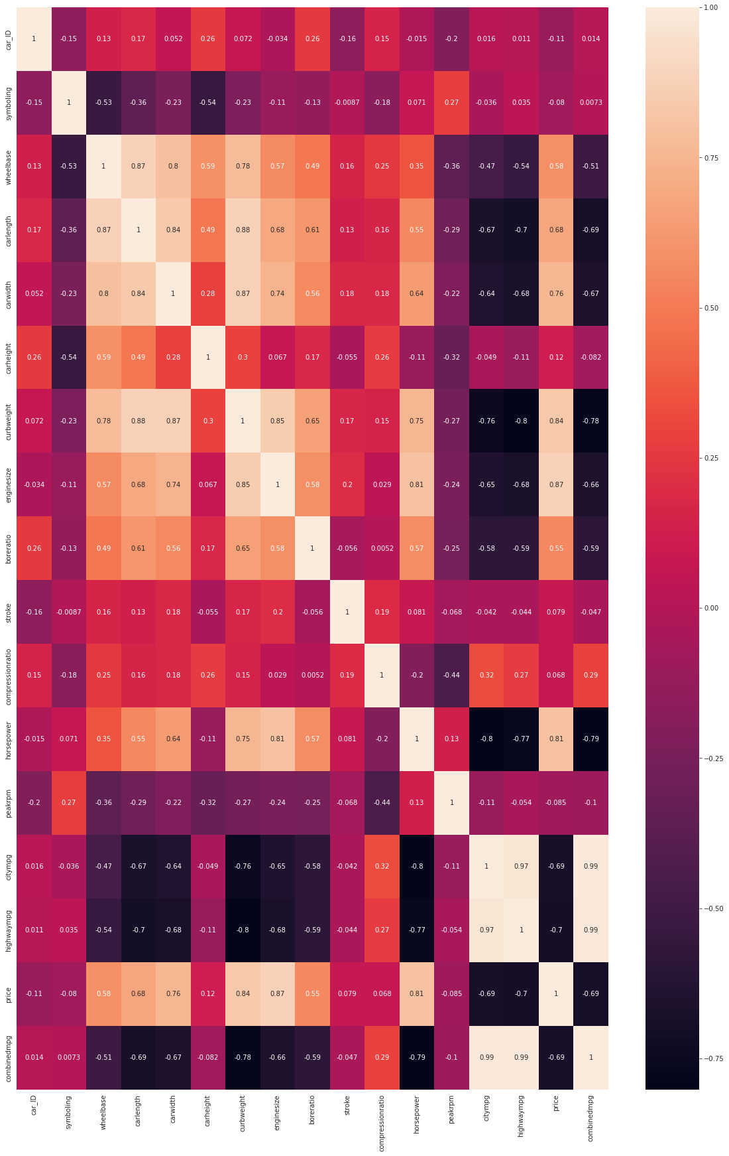
Correlation Map

Slide 9
Features Used in Model
symboling
fueltype
aspiration
doornumber
carbody
drivewheel
enginelocation
wheelbase
carlength
carwidth
curbweight
enginetype
cylindernumber
enginesize
fuelsystem
boreratio
horsepower
citympg
highwaympg
make
combinedmpg

Slide 10
These features are related to one another and they heavily influence the price of cars according to this data.
The biggest factors in influencing the price of cars are engine size, horsepower, mile per gallon and the curbweight. They also affect one another as the bigger engine, the more the curbweight, the higher the horsepower and the poorer the fuel economy.

Slide 11
Models Used
LinearRegression
ARDRegression
QuantileRegressor
LASSO
Ridge
ElasticNet

Slide 12
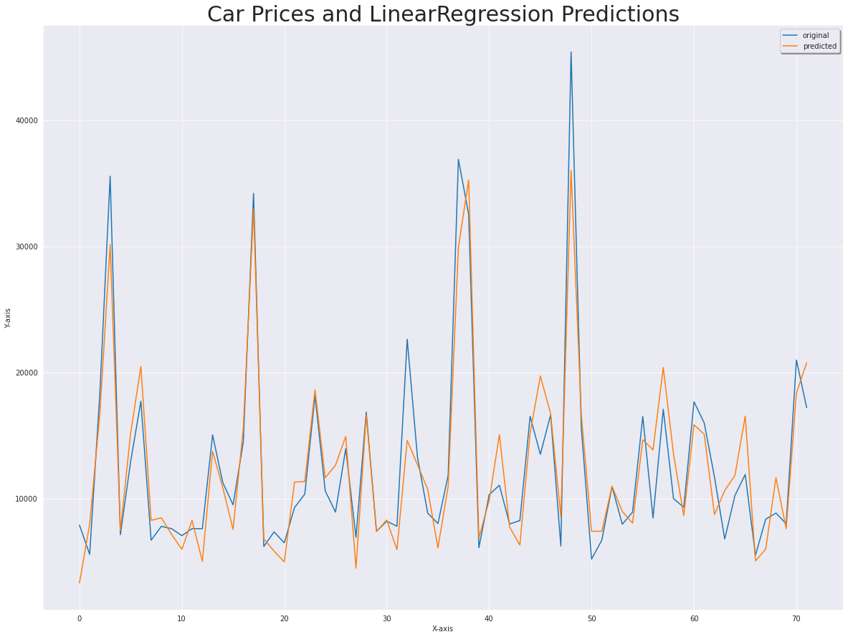
Linear Regression
I got an r2_score of 0.87, a MAE of 2059 and a decent fit of the predicted values with the original values.

Slide 13
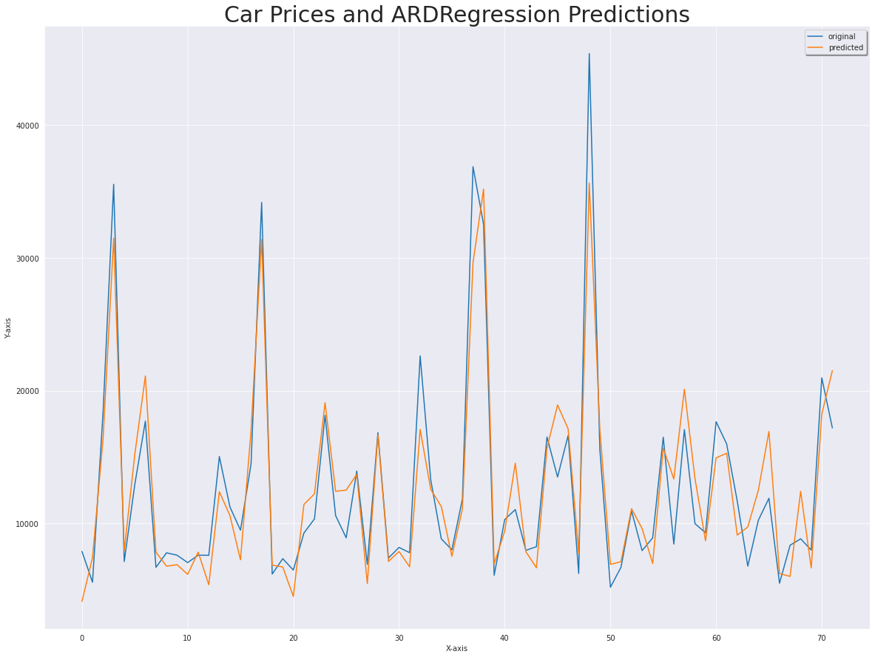
ARDRegression
This model performed well with an r2_score of 0.88, MAE of 2064 and a tighter fit of the predicted prices with the original prices.

Slide 14
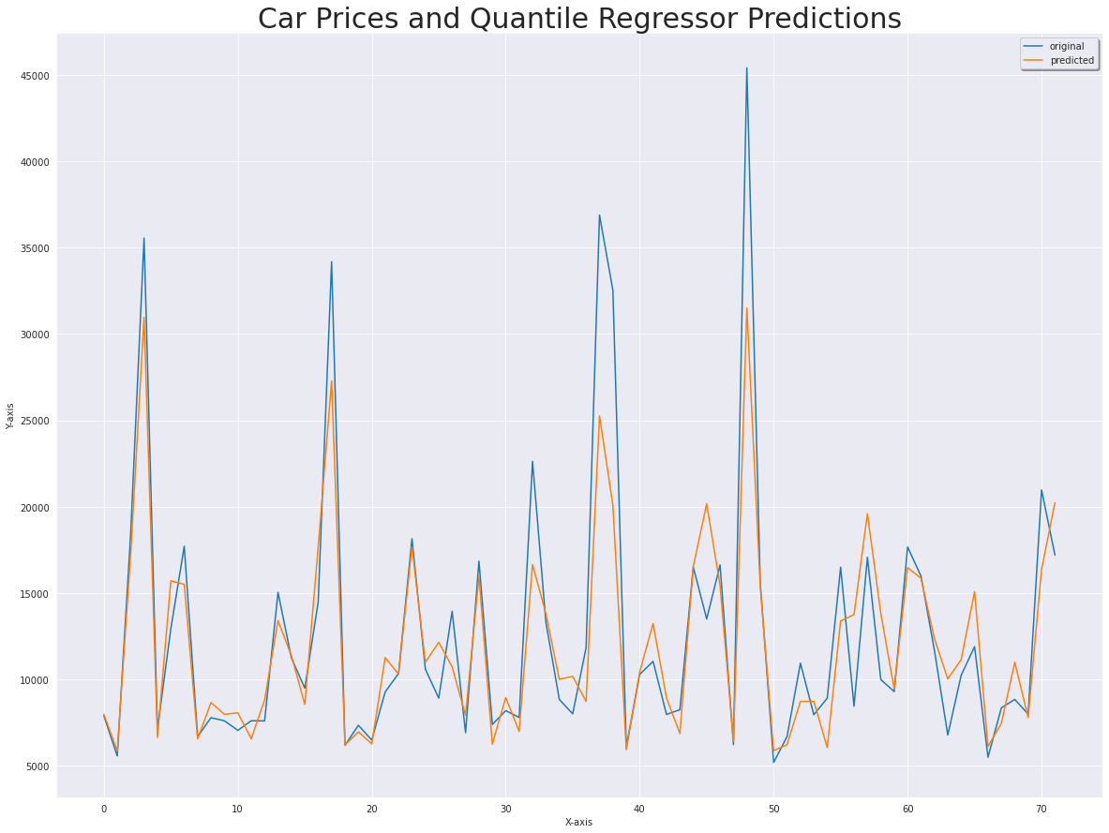
QuantileRegressor
QuantileRegressor performed less than the previous models with an r2_score of 0.80, MAE of 2089 and a less ideal fit.

Slide 15

LASSO
The Least Absolute Shrinkage and Selection Operator(LASSO) selects variables and does regularization to increase the accuracy of the model and I was able to get an r2_score of 0.87 with MAE of 2055.

Slide 16
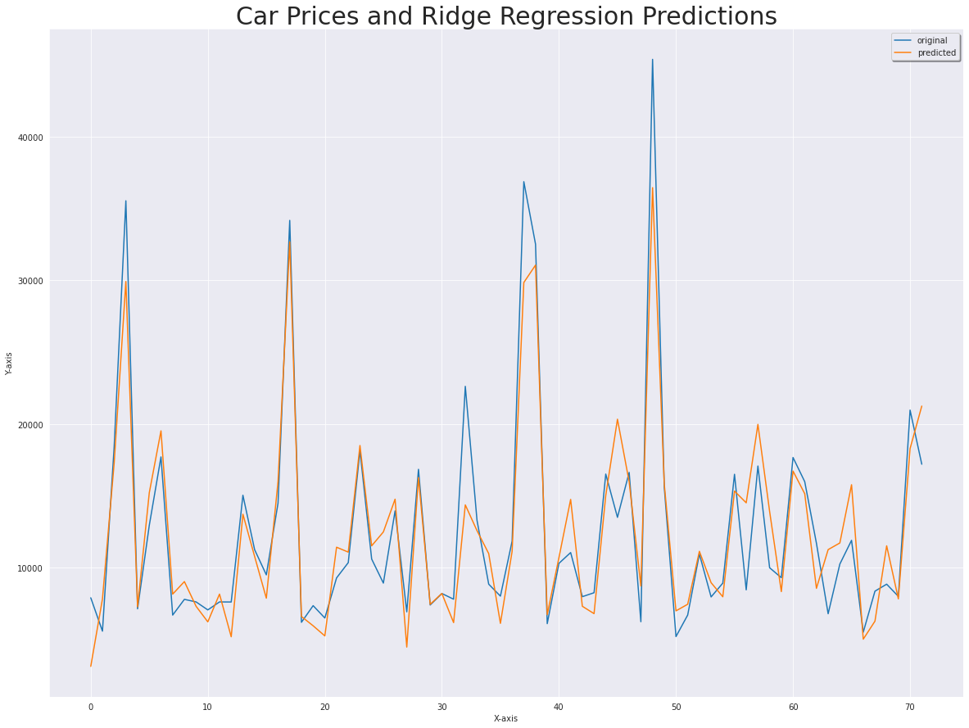
RIDGE
Ridge Regression is used when there is multicollinearity like in this situation. I got an r2_score of 0.87 and a MAE of 1,997.1.

Slide 17
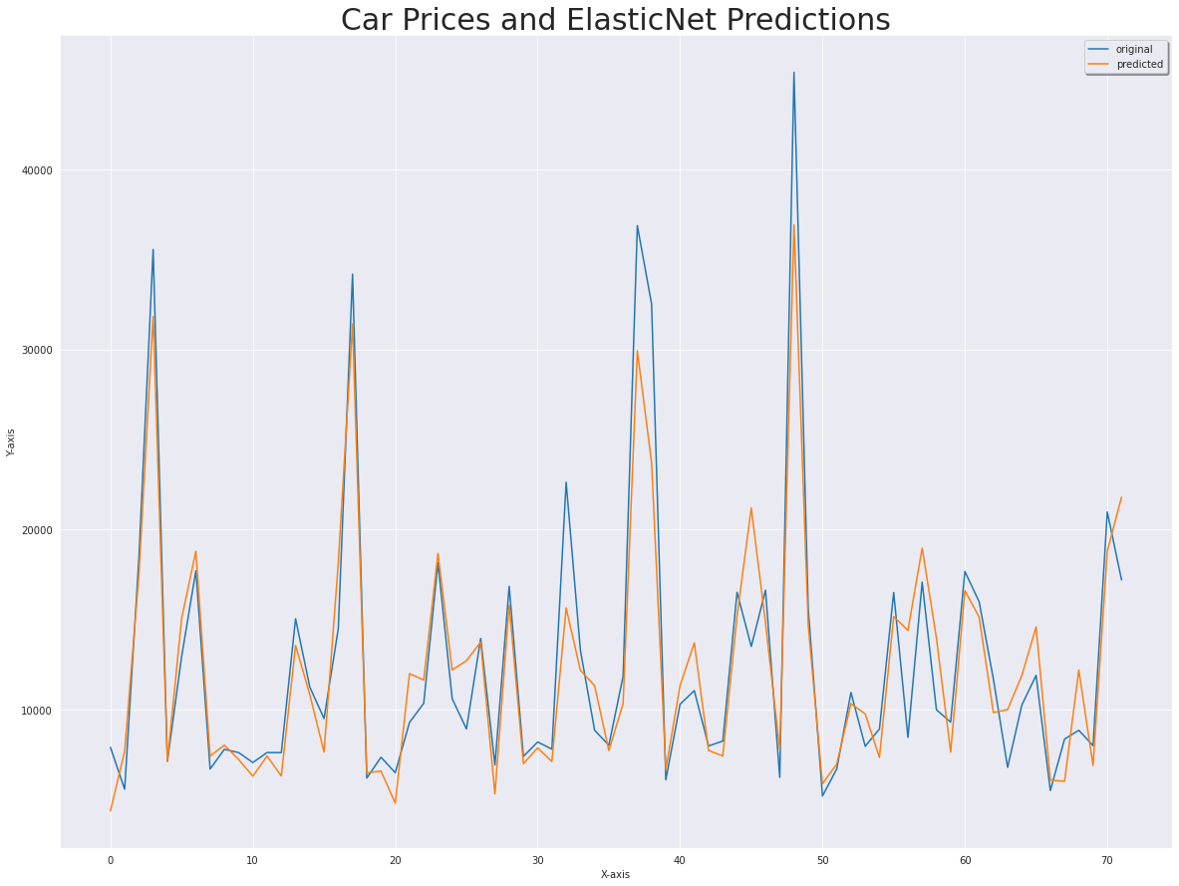
ElasticNet
ElasticNet is a hybrid of LASSO and Ridge regressors. It performed quited well, although not as well as Ridge Regressor. I got an r2_score of 0.87 and MAE of 2010.

Slide 18
The models performed quite well and can be used to find a close enough estimate of prices of cars based on the features listed even though the data is a bit too old to rely on.
When gathering more data to improve the insights, a field should be introduced indicating if the car is a luxury car or a regular car.

Slide 19
Recommendations
For Geely to penetrate the Nigerian market, their main offering should be an inexpensive gas powered four door sedan with great fuel economy and a bit of room for passengers.
An inexpensive gas powered hatchback should be considered too. Again, the keyword is fuel economy.
A more luxurious model can be introduced to capture that small niche that are willing to spend more.
Fresh data should be gathered to keep up with the times.

